Slide 1
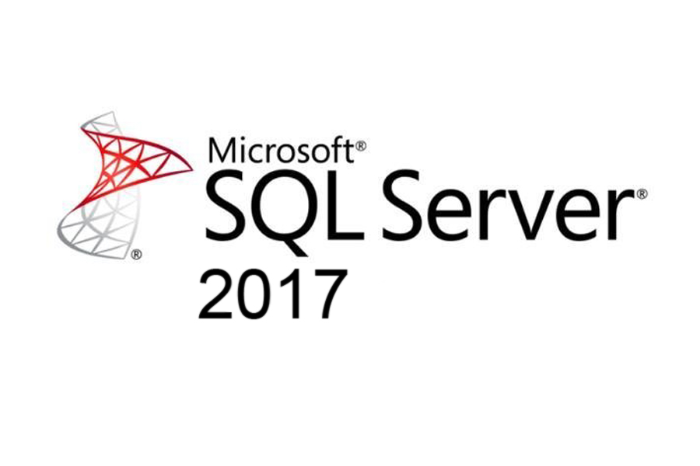
Big Data
Bryan Cafferky
Data Solutions Enabler
https://docs.microsoft.com/en-us/sql/sql-server/editions-and-components-of-sql-server-2017?view=sql-server-2017

Slide 2
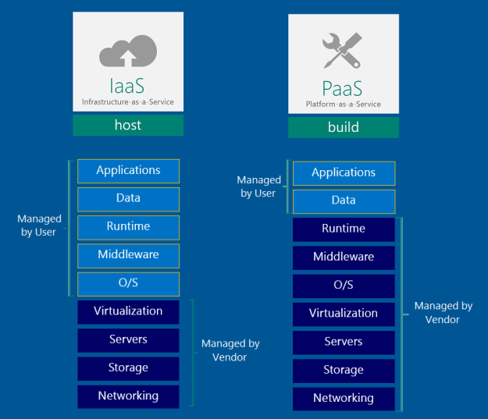

Azure Data Platform

Slide 3

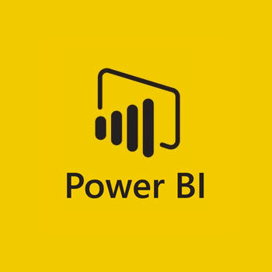
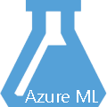

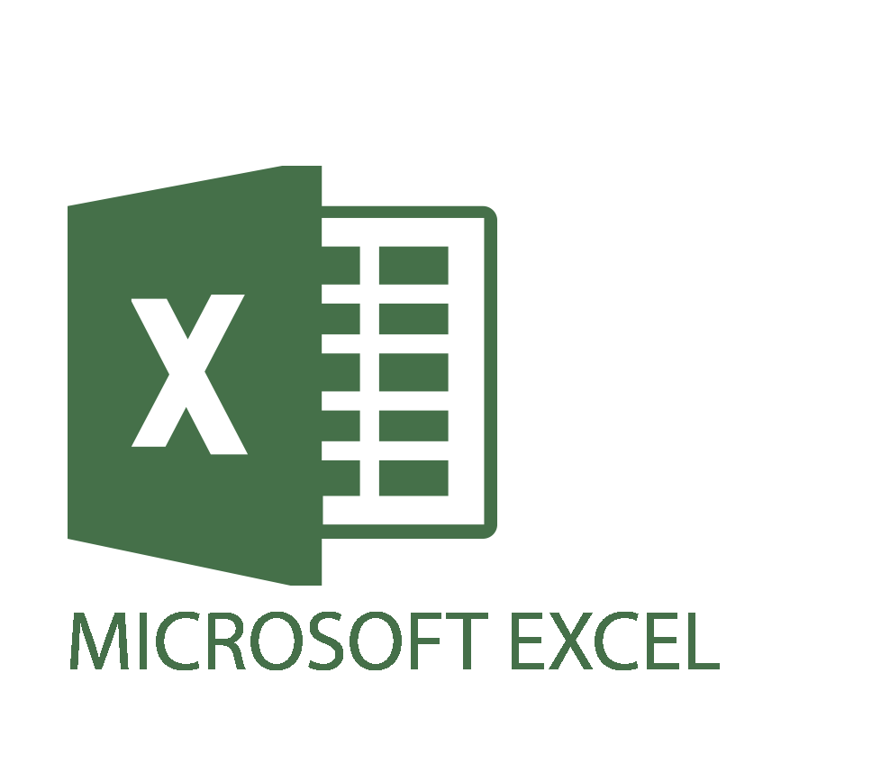





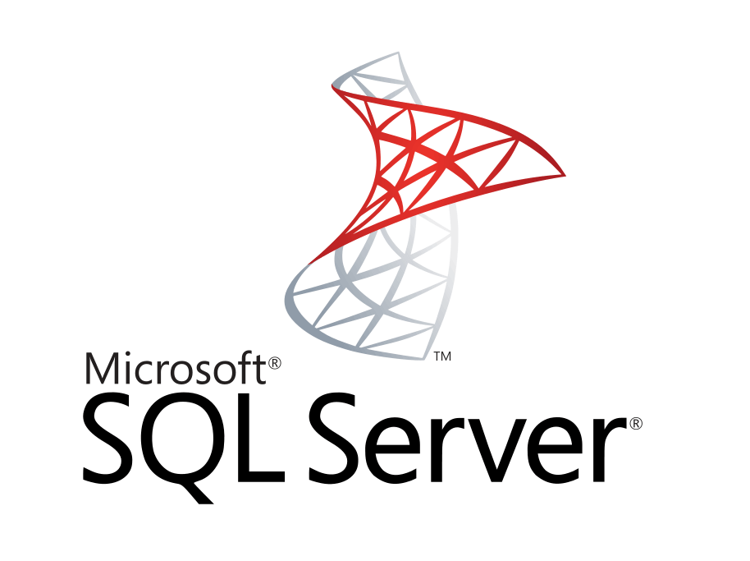


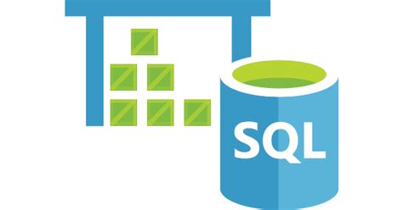
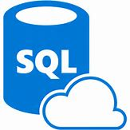



Data Analysis Platform
Client Tools
ML Workbench
Streaming
Azure Data Factory
Data Ingestion
Azure Cognitive
Services
On-Prem
Analysis Services
Data Lake
Analytics
SQL Data Warehouse
Managed Instance/
SQL DB
Cosmos DB
HDInsight
Databricks
Massively Parallel Processing
In Preview
Cloudera via Marketplace
PostgreSQL and MySQL Offered as Azure Services (in preview).
Scale

Slide 4
SQL Server 2017 Industry-leading performance and security NOW ON LINUX and DOCKER
Choice of platform and language
Industry-leading performance
Most secure over the last 8 years⁶
Only commercial DB with AI built-in
End-to-end mobile BI on any device
+
$2,230
R
#1 OLTP performance¹
#1 DW performance on 1TB², 10TB³, and 30TB⁴
#1 OLTP price/performance⁵
#1 DW price/performance on 1TB², 10TB³, and 30TB⁴
Self-service BI per user
T-SQL
Java
C/C++
C#/VB.NET
PHP
Node.js
Python
Ruby
$480
R and Python + in-memory at massive scale
Native T-SQL scoring
$120
Microsoft
Tableau
Oracle
A fraction of the cost
Private cloud
Most consistent data platform
Public cloud
All TPC Claims as of 1/19/2018. ¹http://www.tpc.org/4081; ²http://www.tpc.org/3331; ³http://www.tpc.org/3326; ⁴http://www.tpc.org/3321; ⁵http://www.tpc.org/4080; ⁶National Institute of Standards and Technology Comprehensive Vulnerability Database
Notes:
That’s not all it can do. SQL Server 2017 continues to deliver industry-leading capabilities:
Our latest performance benchmarks on Windows and Linux blow away our old records.
OLTP – We have #1 OLTP TPC-E performance
DW: And, we have the fastest performing DW. With best price/performance.
We offer the most secure database.
According to US National Institute of Standards and Technology (NSIT), we have had fewer vulnerabilities over the last 8 years than Oracle or IBM
Fewer vulnerabilities mean less patching for you!
SQL Server is the first commercial database with Advanced Analytics using R and Python built-in.
Why does this matter to you?
Now you can use SQL Server to operationalize your data science models in a secure and performant way
Use native T-SQL commands to score data in near real-time
And unlike our competitors, mobile BI on every device comes built-in. Or add access to powerful, self-service BI visualizations through Power BI - at a fraction of the cost of our competitors.
SQL Server 2017 gives you your choice of platform and language, and the most consistent on-prem to cloud environment.
And it does all this for 1/10th the cost of Oracle

Slide 5

SQL Sever Service Based Architecture
Database Services
Reporting Services
T-SQL
SQL Agent
Linked Servers
Integrated AD
Encryption
High Availability
Operational Reporting
SQL Server Integration
Mobile Support
Automated Delivery
Rich Functionality
SS EE Power BI Report Server
Machine Learning
Services
In Database R and Python Compilation
Commercial Scalable Libraries for Analysis and ML
Leverages Full SQL Server Features
Operationalization Support (SQL Agent, Stored Procedures, Store Models)
Big Data
Integration Services
Analysis Services
Analytic Reporting Support
In-Memory Tabular Model
Multidimensional Cubes
Ideal for Power BI
First Class ETL
Cross Platform Data
Powerful Developer Tools
Integrated ETL Catalog
http://cliparting.com/free-baby-clip-art-4224/

Slide 6
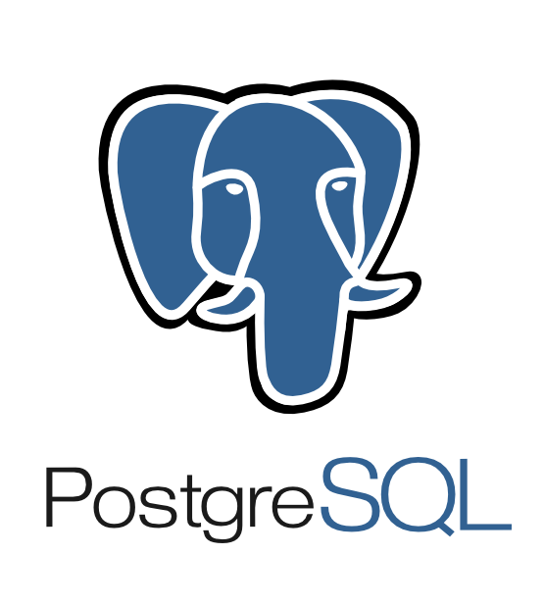
SQL Server Key Features Highlights
SQL Server | Comment
Semantic Layer (SSAS)
ETL (SSIS)
Reporting | Reporting Services/Power BI Report Server
Analytics | Multidimension Cubes and Tabular Model
T-SQL | Extensive SQL Implementation
Job Scheduling | Professional grade job scheduler, SQL Agent.
Client Tools | SQL Server Management Studio SQL Server Data Tools Visual Studio / Database Projects VS Code Full Featured Developer Edition Excel / Power BI Desktop
Machine Learning Support | Python and R with high scalability via commercially enhanced functions.
Big Data

Slide 7
SQL Server Features
SQL Server | Comment
In Memory Tables | High Speed Column Store compressed in memory tables
Column Store | Extremely efficient for ad hoc data analysis
SQL Procedures, Scalar Functions, Table Value Functions
Linked Servers | FDW is more resource intensive because each table must be coded individually.
Extensive Window Functions
Active Directory Integration | Windows Authentication
Master Data Management | Complete facility including GUI to manage master data.
Data Quality Services. | Rich rule based services to enforce data integrity.
Data Compression
Big Data

Slide 8
Power BI REPORT SERVER Self-service BI and enterprise reporting – all in one
Self-service BI and enterprise reporting in one solution
Keep Power BI reports on-premises
Compatible with SSRS
Move to the cloud on your terms
Now an Enterprise edition Software Assurance Benefit
Power BI reports
SSRS reports
Custom visualizations
End-to-end mobile BI on any device
*IDC study “The Business Value and TCO Advantage of Apache Hadoop in the Cloud with Microsoft Azure HDInsight”

Slide 9
Optimized query processing Improved efficiency with Adaptive Query Processing
Optimize memory grants for repeatable queries to avoid over or under allocating
Adjust data join strategy for small or large tables to speed joins
Batch mode for memory grant feedback and adaptive joins
Before
After
101010101010101001
101010010101101010010101
101010010101
101010
Query
101010101010101001010101010101001010
101010101010101001
101001010110
101010101010101001
101010010101101010010101
101010010101
101010
Adaptive Query Processing
101010010101101010
Learn
Memory grant
101010101
101010101
101010101010101001
101010101010101001
101010101
101010101
Run query
Spill to disk
All in memory
Industry-leading performance
Notes:
Analogy – Package shipping. Ship everything in the same big box, at same large expense.
Now, learn over time what size box the query needs and create a box that exactly fits.
This will be more cost effective and create better throughput.
This improvement will cache the actual memory required for a query, such that when an identical query statement is seen, we will be able to use a much more accurate memory grant size, avoiding excessive memory grants that reduce concurrency and avoiding under-estimated memory grants that cause expensive spills to disk.

Slide 10
Automatically fix problems without tuning Better performance with Automatic Plan Correction
Continuous performance plan monitoring and analysis
Detect problematic plans
Automatically fix performance problems caused by SQL plan choice regressions
Query times
Plan 1
Plan 2
Plan 3
Plan 2
Revert to previously effective plan
Industry-leading performance
Notes:
https://blogs.msdn.microsoft.com/sqlserverstorageengine/2017/05/17/automatic-plan-correction-in-sql-server-2017/
https://docs.microsoft.com/en-us/sql/relational-databases/automatic-tuning/automatic-tuning

Slide 11
SQL Server 2017 Analysis Services And real-time operational analytics using in-memory
OLTP
Reporting & Dashboards
Presentation layer
In memory OLTP and SQL Server Analysis Services
BI Semantic Model
DirectQuery—go to the data source directly
IIS Server
SQL Server Analysis Services
Application tier
SQL Server
Analysis Services
In-memory—cache data
Combine data from many places and apply business rules and security
Add columnstore index
Database
Notes:
So to summarize there are 2 specific scenarios when connecting Analysis Services to SQL Server that has columnstore index enabled for specific tables.
First you can benefit from the BI semantic model by connecting to the SQL Server database directly. Second – you can use Analysis Services using the in-memory storage mode – especially when you need to combine data from multiple sources.

Slide 12
Why temporal
Data changes over time
Tracking and analyzing changes is often important
Temporal in DB
Automatically tracks history of data changes
Enables easy querying of historical data states
Advantages over workarounds
Simplifies app development and maintenance
Efficiently handles complex logic in DB engine
Time travel
Data audit
Slowly changing dimensions
Repair record-level corruptions
Performance
Notes:
Source: https://msdn.microsoft.com/en-us/library/dn935015(v=sql.130).aspx
A temporal table is a new type of table that provides correct information about stored facts at any point in time. Each temporal table consists of two tables actually, one for the current data and one for the historical data. The system automatically ensures that when the data changes in the table with the current data, the previous values are stored in the historical table. Querying constructs are provided to hide this complexity from users. For more information, see Temporal Tables.
Introduction to Key Components and Concepts
What is a Temporal Table?
A temporal table is a table for which a PERIOD definition exists and which contains system columns with a datatype of datetime2 into which the period of validity is recorded by the system, and which has an associated history table into which the system records all prior versions of each record with their period of validity. With a temporal table, the value of each record at any point in time can be determined, rather than just the current value of each record. A temporal table is also referred to as a system-versioned table.
Why Temporal?
Real data sources are dynamic and more often than not business decisions rely on insights that analysts can get from data evolution. Use cases for temporal tables include:
Understanding business trends over time
Tracking data changes over time
Auditing all changes to data
Maintaining a slowly changing dimension for decision support applications
Recovering from accidental data changes and application errors

Slide 13
How to start with temporal
ANSI 2011 compliant
No change in programming model
New Insights
CREATE temporal TABLE PERIOD FOR SYSTEM_TIME…
ALTER regular_table TABLE ADD PERIOD…
DML
Temporal Querying
SELECT * FROM temporal
FOR SYSTEM_TIME
AS OF
FROM..TO
BETWEEN..AND
CONTAINED IN
INSERT / BULK INSERT
UPDATE
DELETE
MERGE
DDL
Querying
Performance
Notes:
Source: https://msdn.microsoft.com/en-us/library/dn935015(v=sql.130).aspx
How Does Temporal Work?
System-versioning for a table is implemented as a pair of tables, a current table and a history table.
Within each of these tables, two additional datetime (datetime2 datatype) columns are used to define the period of validity for each record – a system start time (SysStartTime) column and a system end time (SysEndTime) column.
The current table contains the current value for each record. The history table contains the each previous value for each record, if any, and the start time and end time for the period for which it was valid.
INSERTS: On an INSERT, the system sets the value for the SysStartTime column to the UTC time of the current transaction based on the system clock and assigns the value for the SysEndTime column to the maximum value of 9999-12-31 – this marks the record as open.
UPDATES: On an UPDATE, the system stores the previous value of the record in the history table and sets the value for the SysEndTime column to the UTC time of the current transaction based on the system clock. This marks the record as closed, with a period recorded for which the record was valid. In the current table, the record is updated with its new value and the system sets the value for the SysStartTime column to the UTC time for the transaction based on the system clock. The value for the updated record in the current table for the SysEndTime column remains the maximum value of 9999-12-31.
DELETES: On a DELETE, the system stores the previous value of the record in the history table and sets the value for the SysEndTime column to the UTC time of the current transaction based on the system clock. This marks this record as closed, with a period recorded for which the previous record was valid. In the current table, the record is removed. Queries of the current table will not return this value. Only queries that deal with history data return data for which a record is closed.
MERGE: On a MERGE, MERGE behaves as an INSERT, an UPDATE, or a DELETE based on the condition for each record.

Slide 14
Security
SQL Server provides enterprise-grade security capabilities on Windows and on Linux. All built in.
Protect Data
Encryption at rest Transparent Data Encryption
Backup Encryption
Cell-level encryption
Encryption in transit Transport Layer Security (SSL/TLS)
Encryption in use (client) Always Encrypted
SQL
Control access
Database access SQL Server Authentication
Active Directory authentication
Granular permissions
Application access Row-Level Security
Dynamic data masking
Monitor access
Tracking activities Fine-grained audit
Notes:
[this slide has animation]
SQL Server provides enterprise-grade security capabilities on Windows and on Linux
[click]
We think about security for SQL Server in terms of layers. At the center, you have your data and how you protect the data itself, typically using encryption. SQL Server supports a variety of encryption features to help protect your data against different types of threats.
Transparent Data Encryption (TDE) encrypts your whole database at rest, without requiring any application changes. Backup Encryption encrypts your backup files, and Cell-Level Encryption gives you granular control over the encryption of individual cells of data.
To encrypt data in transit to and from the database, SQL Server supports the industry-standard TLS 1.2 protocol.
And finally, Always Encrypted enables you to encrypt sensitive data client-side, so that even privileged SQL Server administrators are unable to see it in plaintext.
[click]
The next layer is about controlling access to the data.
SQL Authentication allows users to authenticate via a username and password, while Active Directory Authentication allows users to authenticate using single sign-on through Active Directory and Kerberos. Granular permissions enable you to control access to individual tables or even columns of data.
Row-Level Security allows you to control read- and write-access to individual rows of data based on a customizable policy, and Dynamic Data Masking allows you to easily mask fields (such as account numbers) so that only part of the data can be seen.
[click]
The last layer is about monitoring who accesses the data.
SQL Server’s Fine-Grained Audit feature allows you to enforce a data audit policy and track which users are doing which actions.
[click]
So that’s where we’re going with security for SQL Server on Linux. Almost all of these features are already available for you to try in the CTP1 preview release, please try them out and share your feedback with us. Support for TLS is in progress and will become available in an upcoming build. Similarly, Active Directory Authentication is one of our most requested features and will become available in an upcoming build.

Slide 15



Introducing SQL Server Graph
A collection of node and edge tables in the database
Language Extensions
DDL Extensions – create node and edge tables
DML Extensions – SELECT - T-SQL MATCH clause to support pattern matching and traversals; DELETE, UPDATE, and INSERT support graph tables
Graph support is integrated into the SQL Server ecosystem
Database
Contains
Graph
isCollectionOf
Node Table(s)
Edge Table(s)
Node table has Properties
Edges connect Nodes
Edge table may or may not have Properties
Notes:
Each SQL Server 2017 database supports up to one graph. A graph is a collection of node and edge tables; node and edge tables can be distributed across more than one schema in the database, but all belong to the same logical graph. Nodes and edges are stored in standard SQL Server tables, so most of the operations that can be carried out on a standard SQL Server table can also be carried out on graph tables.
When a table is created as a node or edge table, a number of metadata columns are automatically added to the table – these are used to provide graph support.
Additional columns are added to the sys.tables and sys.columns system views to allow graph tables to be identified.
For more detail on the architecture of graph tables, see https://docs.microsoft.com/en-us/sql/relational-databases/graphs/sql-graph-architecture

Slide 16
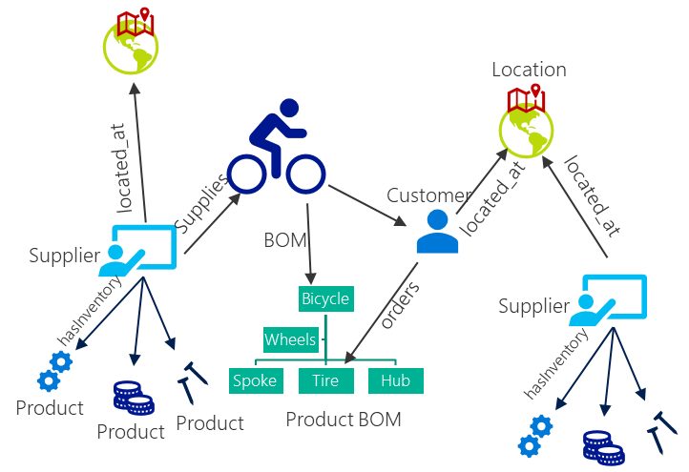
DDL Extensions
Create node and edge tables
Properties associated with nodes and edges
CREATE TABLE Product (ID INTEGER PRIMARY KEY, name VARCHAR(100)) AS NODE;
CREATE TABLE Supplier (ID INTEGER PRIMARY KEY, name VARCHAR(100)) AS NODE;
CREATE TABLE hasInventory AS EDGE;
CREATE TABLE located_at(address varchar(100)) AS EDGE;
Notes:
The code on the slide creates two node tables (Product and Supplier) and two EDGE tables (hasInventory and located_at)

Slide 17
DML Extensions
Multi-hop navigation and join-free pattern matching using the MATCH predicate:
SELECT Prod.name as ProductName,
Sup.name as SupplierName
FROM Product Prod, Supplier Sup,
hasInventory hasIn,
located_at supp_loc,
Customer Cus,
located_at cust_loc,
orders, location loc
WHERE
MATCH(
cus-(orders)->Prod<-(hasIn)-Sup
AND
cus-(cust_loc)->location<-(supp_loc)-Sup
) ;
Notes:
The query on the slide uses the MATCH clause to perform a join-free search of the graph to find products and suppliers where a customer at the same location as the supplier has ordered a product that the supplier has in stock.
These orders could potentially be fulfilled by the supplier dispatching direct to the customer.

Slide 18
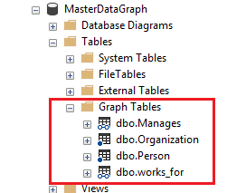
Integrated into the SQL Engine
Existing tools all work out of the box, for example SSMS, backup and restore, import / export, etc.
Queries can join existing tables and graph node / edge tables.
Columnstore Indexes, ML (R / Python), HA etc.
Security and Compliance: Dynamic Data Masking, Row Level Security
Available on SQL Server on Linux as well!

Slide 19
Spatial
Spatial data represents information about the physical location and shape of geometric objects. These objects can be point locations, or lines, or more complex objects such as countries, roads, or lakes.
SQL Server supports two spatial data types: the geometry data type and the geography data type.
The geometry type represents data in a Euclidean (flat) coordinate system.
The geography type represents data in a round-earth coordinate system.
Notes:
Source: https://docs.microsoft.com/en-us/sql/relational-databases/spatial/spatial-data-sql-server

Slide 20
Spatial functionality
Simple and compound spatial data types supported
Import and export spatial data to industry-standard formats (Open Geospatial Consortium WKT and WKB)
Functions to query the properties of, the behaviours of, and the relationships between, spatial data instances
Spatial columns can be indexed to improve query performance
Notes:
Source: https://docs.microsoft.com/en-us/sql/relational-databases/spatial/spatial-data-types-overview
Source: https://docs.microsoft.com/en-us/sql/relational-databases/spatial/create-construct-and-query-geometry-instances
Source: https://docs.microsoft.com/en-us/sql/relational-databases/spatial/create-construct-and-query-geography-instances

Slide 21
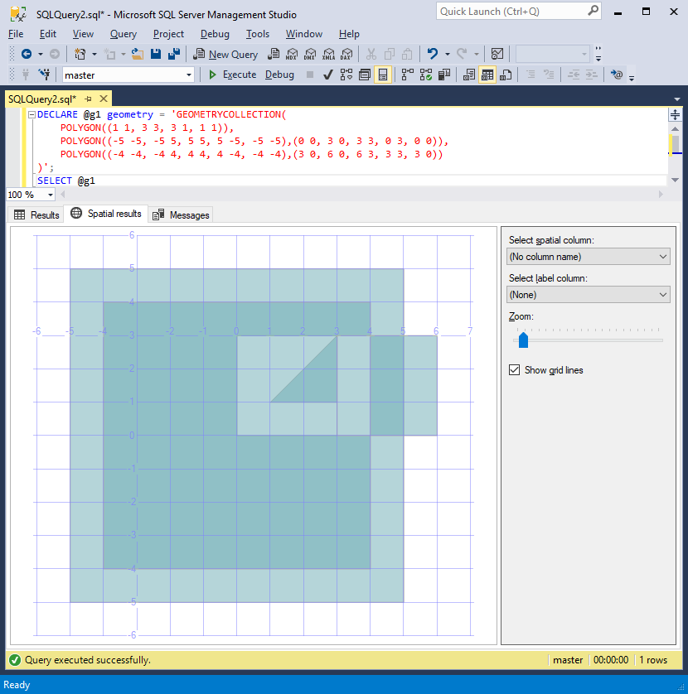
Spatial tooling
SSMS includes the ability to display a visual representation of spatial results

Slide 22
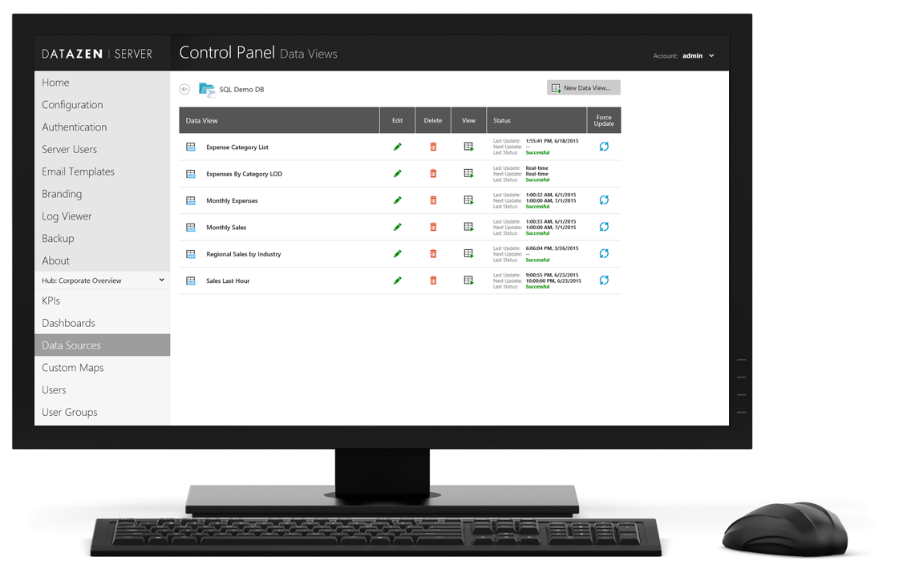
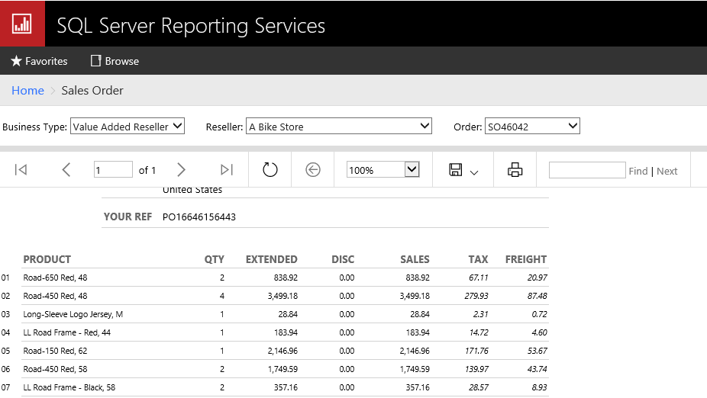
Report parameters
Adjust parameter values to filter results or toggle report options
Drop-down lists, date pickers, true/false, and textboxes
Specify parameter values via URL
Notes:
Report users
Easily interact with paginated report to get insights with the parameter pane built into the report
Report authors
Customizable parameter layout. Report authors can have more control over the parameter layouts, including the ability to have multiple parameter columns and better control over the position of the parameters. Using the design surface in Report Builder, you can drag a parameter to a specific column and row in the parameter pane.
You can add and remove columns to change the layout of the pane

Slide 23
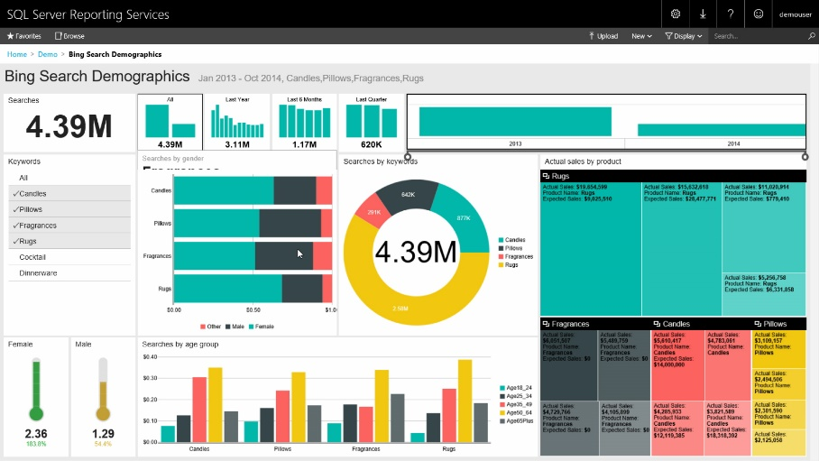
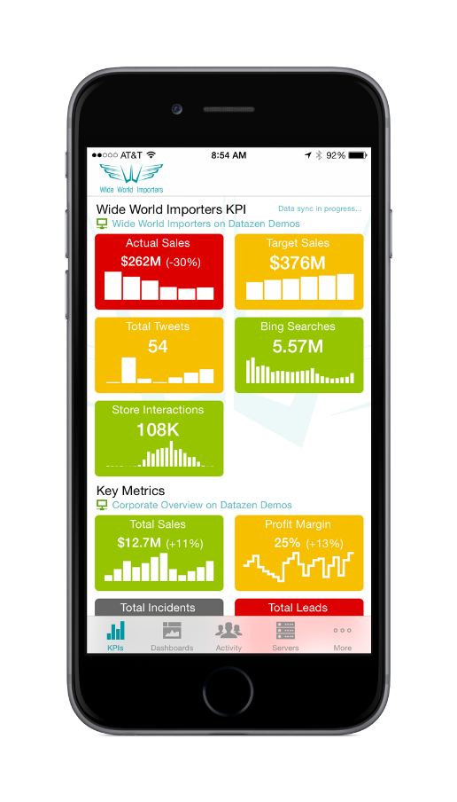
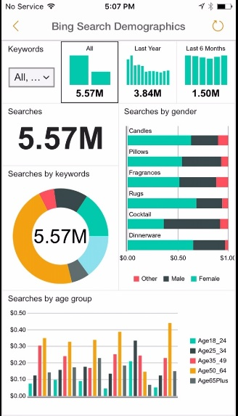
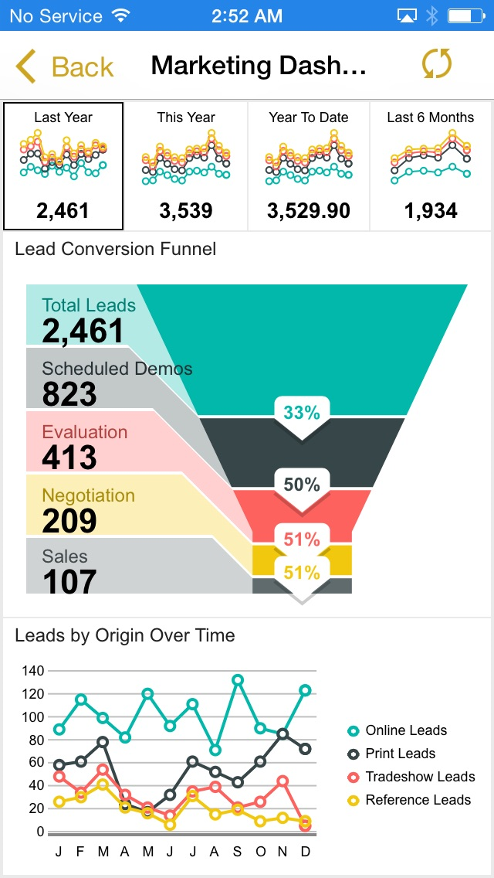

Mobile reports
Responsive experiences for phones and tablets
One mobile app for Power BI and Reporting Services mobile reports
Native mobile experience optimized for touch
Keep data up-to-date with real-time query or scheduled data refresh
Interact with mobile reports even when disconnected
Windows
iOS
Android
HTML5
Notes:
Key points:
Mobile reports dynamically adjust the content to fit your screen (or browser window). You never see content scrolled out of view or flowing onto a different page.
While you can view these reports on your PC as well, they're really optimized for mobile devices
Talk track:
You only need one mobile app to access Power BI and SSRS mobile reports. Power BI apps are available for all major mobile platforms.
Connect to your on-premises SSRS server and view your KPIs and mobile reports
In addition to access via mobile devices you can also access your data via HTML rendering from your browser.
The Power BI app to view Reporting Services mobile reports and KPIs is available in preview for iOS and Android here:
For iPhone: https://itunes.apple.com/us/app/microsoft-power-bi/id929738808?mt=8
For Android: https://play.google.com/store/apps/details?id=com.microsoft.powerbim

Slide 24
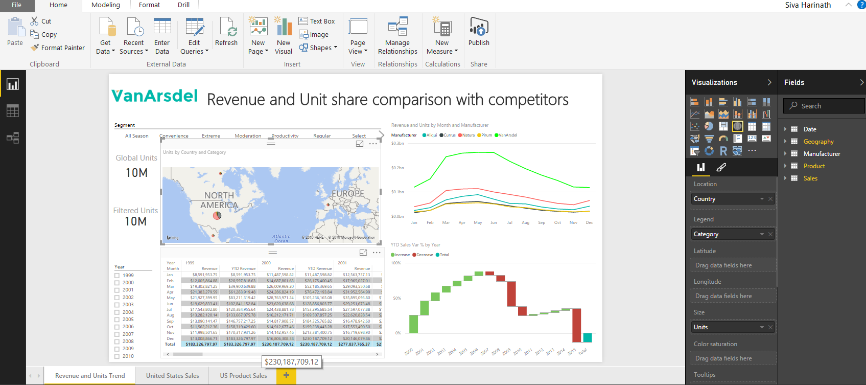
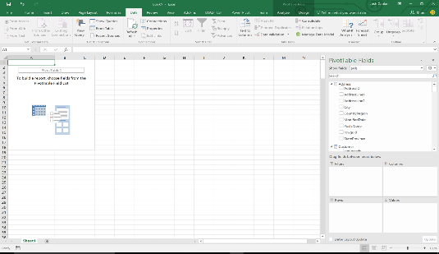
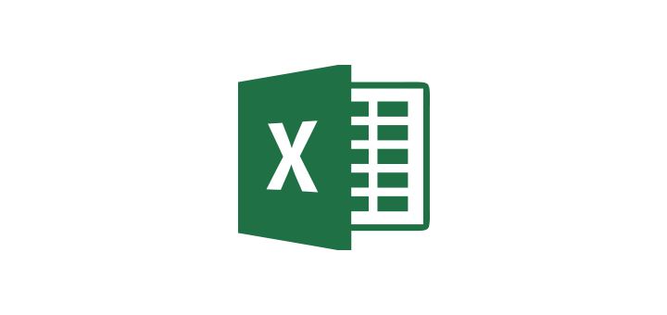
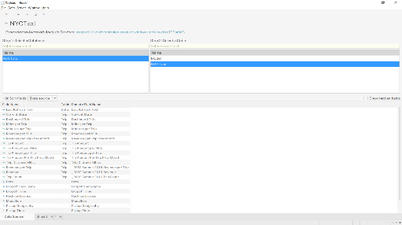

Easy to consume Support for major BI tools
Power BI
SSAS
SQL Server Analysis Services
Excel
Other third-party tools & services
Notes:
Key points:
Consuming with Power BI, Excel or 3rd party tools like Tableau
Support for major BI tools

Slide 25

One semantic model—two ways to develop
Tabular models
Multidimensional models
Tables and relationships
Fast by design with in-memory
Easy to get started and simple
Dimensions and measure groups
Highly scalable and mature
Feature rich and complex
Notes:
Key Points (depending on the audience you might only show this slide or prior slide)
Overview of the semantic model options in SQL Server Analysis Services.
Tack track:
A BI semantic model allows you to easily abstract business problems and turn complex data into models that can be easily understood and can be used for reporting, analytics and dashboards.
SQL Server Analysis Services allows you to create one BI semantic model to be used with different client tools.
There are 2 ways to build it:
Tabular – consists of tables and relationships. Are fast by design with in-memory and are easy to get started.
Multidimensional – consists of dimensions and measure groups. Are highly scalable and mature, very feature rich but can add complexity.

Slide 26

SQL Server Analysis Services
Client tools
Third-party applications
Excel
SSRS paginated reports
SSRS mobile reports
Power BI Desktop
PowerBI.com
Bi semantic model
Use SQL Server data tools for Visual Studio to create BI semantic models
Queries
MDX/DAX (all model types)
Data model
Multidimensional
Tabular
Business logic
MDX
DAX
Data access
MOLAP
ROLAP
In-memory
DirectQuery
Data sources
Relational databases
LOB applications
Cloud services
Analytics platform system
Notes:
Key Points:
Technical overview of SQL Server Analysis Services.
Talk track:
Microsoft SQL Server Analysis Services enables BI developers to build powerful, easy to use analytic solutions by providing:
A choice of semantic model to provide an intuitive abstraction over complex data, for use by business analysts through tools like Excel or Power BI Desktop, either a traditional multi-dimensional model or a simpler, modern tabular model
To either cache data in a high performance analytic data store (MOLAP or in-memory/VertiPaq for Tabular) and/or leave data in its source system and access it with direct queries.

Slide 27
TMSL continued Tabular models (1200 & 1400)
The script to represent the schema of the model was developed together with the Power BI team, with the goal to have feature parity with the Power BI APIs to allow reusability between products
SSAS PowerShell cmdlet Invoke-ASCmd accepts tabular model scripting language commands

Slide 28


Combine the best of open source languages with Microsoft innovation
Languages
Big data scale
Innovations
Run any open source R or Python
Leverage thousands from packages in R & Python open source communities
Scale and accelerate R with RevoScaleR, revoscalepy, MicrosoftML parallelized libraries
Innovate in AI with Deep Neural Network tookit
Deploy common AI easily including prebuilt neural networks
Innovate with open source AI such as Tensorflow & Theano
RevoScaleR Library
T-SQL Integration
MicrosoftML Library
Real-Time Scoring
Ensemble & GroupBy Modeling
Deep Neural Networks
revoscalepy Library
Pre-Trained Image & Text Featurizers
Notes:
Last but not least, customers need flexibility when it comes to the choice of platform, programming languages & data infrastructure to get from the most from their data.
Why? In most IT environments, platforms, technologies and skills are as diverse as they have ever been, the data platform of the future needs to you to build intelligent applications on any data, any platform, any language on premises and in the cloud.
SQL Server manages your data, across platforms, with any skills, on-premises & cloud
Our goal is to meet you where you are with on any platform, anywhere with the tools and languages of your choice.
SQL now has support for Windows, Linux & Docker Containers.
It allows you to leverage the language of your choice for advanced analytics – R & Python.

Slide 29
Tackle bigger data with SQL Server 2017 Machine Learning Services
Open Source R & Python
Machine Learning Services
Open Source R and Python are designed to use only a single thread (processor) at a time
R and Python work with parallelized algorithms in Machine Learning Services to scale analytics scale-out and scale-up algorithms
Parallel Worker tasks
CPU
CPU
CPU
CPU
CPU
Notes:
Slide Objective:-
Show how Microsoft R outperforms Open Source R
Talking Points:-
Open Source R libraries are single threaded and all computation happens sequentially.
Microsoft R offers scalable parallelized algorithms that use R Server’s multithreaded processing to offer superior performance.
The multi-core machines of today offer parallel processing power. To take advantage of this, Microsoft R provides multi-threaded math libraries. These libraries automatically use all available cores and processors to significantly reduce computation times — without the need to change a line of your R code.

Slide 30

RevoScaleR Library: Parallel, distributed algorithms
Data step
Data import – Delimited, Fixed, SAS, SPSS, OBDC
Variable creation & transformation
Recode variables
Factor variables
Missing value handling
Sort, Merge, Split
Aggregate by category (means, sums)
Statistical tests
Chi Square test
Kendall Rank Correlation
Fisher’s Exact test
Student’s t-test
Variable selection
Stepwise Regression
Simulation
Simulation (e.g. Monte Carlo)
Parallel random number generation
Sampling
Subsample (observations and variables)
Random Sampling
Cluster analysis
K-Means
Descriptive statistics
Min/max, mean, median (approx.)
Quantiles (approx.)
Standard deviation
Variance
Correlation
Covariance
Sum of squares (cross product matrix for set variables)
Pairwise cross tabs
Risk ratio & odds ratio
Cross-tabulation of data (standard tables & long form)
Marginal summaries of cross tabulations
Predictive models
Sum of Squares (cross product matrix for set variables)
Quantiles (approx.)
Generalized Linear Models (GLM) exponential family distributions: binomial, Gaussian, inverse Gaussian, Poisson, Tweedie. Standard link functions: cauchit, identity, log, logit, probit. User defined distributions & link functions.
Covariance and correlation matrices
Logistic regression
Linear regression
Predictions/scoring for models
Residuals for all models
Classification
Decision Trees
Decision Forests
Gradient Boosted Decision Trees
Naïve Bayes
Custom parallel
rxDataStep
rxExec
rxExecBy – groupby/many-models
PEMA-R API custom algorithms
Notes:
Slide Objective
Present the range of already parallelized functions and algorithms available with RevoScaleR
Talking Points
This list shows the functions and algorithms that are available with all versions of R Server.
We call this the ScaleR Library.
Each function can:
Execute work in step in parallel or serial as needed
Process work using multiple threads, cores, sockets or nodes
Process one or more data block in each thread, core, socket or node
Combine the results into a single mathematically correct answer
Do the work either locally or ship the request to another system for completion remotely.
Completely obscure the complexity of parallelization, multiple steps and iterations from the R programmer
Four functions, rxDataStep, rxExec, PEMA-R, and the newest rxExecBy provide frameworks for users to write their own routines – functions – algorithms using parallelization.
While more difficult than pre-written PEMAs, the results are portable – usable on multiple systems
Easier than writing directly to the platform to create custom algorithms.
Notes:
One algorithm framework – PEMA-R API, is not available in clustered systems – an exception to creating portability across systems.

Slide 31
Scale your R environment across platforms
Cloud
Big Data
R Server for HDInsight
Linux and Windows Servers
Virtual Machines
Data scientist
workstation
Hybrid
Our data science tool that allows you to do high performance analytics on production data, running locally on your computer
On-premises
In-Database
SQL Server 2017 (Machine Learning Services)
Big Data
R Server for Hadoop/Spark
R Server for Teradata
Linux and Windows Servers
R Server for Linux and Windows
R Client (free)
Notes:
On the left we have left we have R client which offers two things to data scientists
They can leverage all the Microsoft R packages locally on their workstations
Second, they can push the compute and bid data analytics to where the data lives. This gives them access to the power of servers and eliminates need for data movement, reducing time and increasing security
On the right is our commitment of meeting customers where they are, and where their data lives.

Slide 32
Get going now!
1
Download SQL 2017
Install the evaluation edition of SQL Server 2017 from:
https://www.microsoft.com/en-us/evalcenter/evaluate-sql-server-2017-rtm/
2
Install Visual Studio
Install Visual Studio Community from:
https://www.visualstudio.com/thank-you-downloading-visual-studio/?sku=Community&rel=15
3
Build a predictive model
Build a Python predictive model in SQL Server using this tutorial:
https://docs.microsoft.com/en-us/sql/advanced-analytics/tutorials/machine-learning-services-tutorials#a-namebkmkpythontutorialsapython-tutorials
4
Take a data science walkthru
Do an end-to-end data science walkthrough in R using this tutorial:
https://docs.microsoft.com/en-us/sql/advanced-analytics/tutorials/walkthrough-data-science-end-to-end-walkthrough

Slide 33
In-database analytics with SQL Server 2017
Scale through parallelization
Extend R and Python analytics with parallelized algorithms that scale up and out
Extensibility
R integration
Python integration
Speed analysis by reducing movement
Analyze data in-place, reducing movement delay, duplication, and potential security risks
Scale R and Python beyond available memory
Overcome the most common demand of data scientists tackling big data assets
Data Scientist
Analytics library
Interacts directly with data
010010
100100
010101
010010
100100
010101
Directly operationalize scripts and models
Operationalize R or Python scripts & models over SQL Server data by calling familiar T-SQL stored procedures from your application
010010
100100
010101
SQL Developer/DBA
T-SQL interface
Relational data
Manage data and
analytics together
Notes:
Slide Objective:
Showcase the benefits of Microsoft Machine Learning Services built into SQL Server 2017
Talking Points:-
With SQL Server 2017 – Microsoft has built R as well as new Python services right into the database. This gives you enhanced analytics capabilities while keeping your TCO low.
Reduce data movement – With in-database analytics you can bring the analytics to the data instead of having to make copies of your data which can lead to erroors.
Operationalize R and Python scripts and model – using familiar T-SQL procedures. Reduce the pains of operationalizing your analytics code.
R with in-memory scalability – In-memory analytics gives your data scientists much better speed and performance allowing you to scale to large data sets.

Slide 34
Database Engine new features
Enhanced performance for natively complied T-SQL modules
OPENJSON, FOR JSON, JSON
CROSS APPLY operations
Computed columns
New string functions
TRIM, CONCAT_WS, TRANSLATE, and STRING_AGG with support for WITHIN GROUP (ORDER BY)
BULK IMPORT now supports CSV format and Azure Blob Storage as file source

Slide 35
Q & A

